Slide 1
CYB 110 CYBERSECURITY AND PRIVACY MODULE 3 - AUTHORIZATION & ACCESS CONTROL JIM ALVES-FOSS AND JIA SONG

Slide 2
AUTHORIZATION
Authorization is the process of determining exactly what an authenticated party can do.
Authorization is typically implemented using access control.
The basis of computer security is controlled access:
Someone is authorized to take some action on something.
We need to be sure who the someone is.
Identification
Authentication
Access Control
Subject
Object
Access right

Slide 3
Access controls are Mechanisms and processes that provide authorization based on an authenticated identity or other attribute of data or entities in the systems.
A subject is permitted to access an object in a particular mode, and only such authorized accesses are allowed [GRA72].
Subjects are human users.
Objects are things on which an action can be performed.
Access mode are any controllable actions (read, write, execute).

Slide 4
ACCESS CONTROLS
In general we used these to: (subject, action, object)
Allow access: Give an entity access to a resource (read/write a file, enter a building, run a program)
Denying access: Opposite of allowing access. Good security systems deny by default.
Limiting Access: Maybe read-only access
Revoking Access: May want to deny access that was permitted in the past.

Slide 5
ACLS
An access control list (ACL) is a computer system implementation for managing authorization.
Typically this is a list of permissions for an authenticated user or group.
These permissions state what actions that entity is allowed to perform on a specified resource.
Example: Files and Directories in a computer system will typically have: read, write, execute permissions.

Slide 6
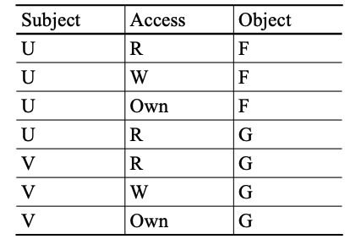
LIST OF ACCESS CONTROL TRIPLES
Triple - <subject, object, rights>
Advantage: avoid empty cells of the matrix.
Disadvantage: searching through a large number of triples is inefficient.

Slide 7
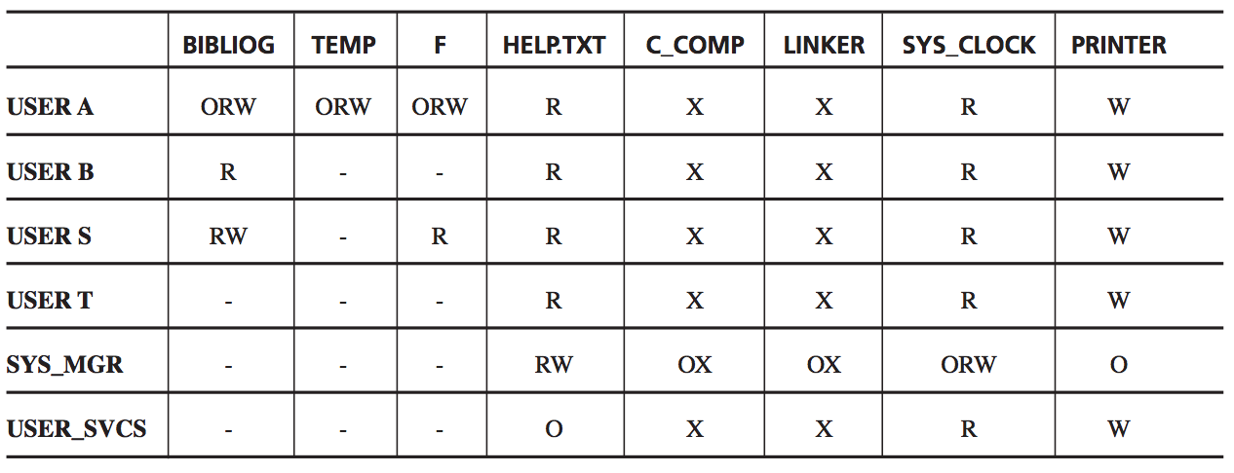
ACCESS CONTROL MATRIX (EXAMPLE)
Notes:
In general, most entries in the access control matrix are empty (most subjects do not have access rights to most object)

Slide 8
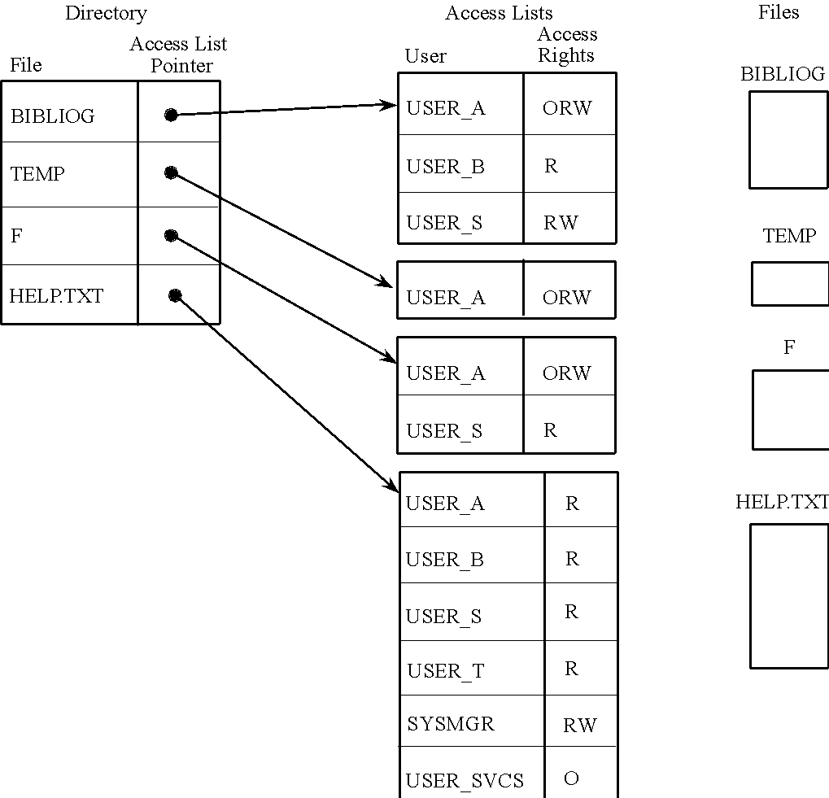
ACCESS CONTROL LIST
One access list for each object, and the list shows all subjects who should have access to the object and what their access rights are.
Advantages:
It can include general default entries for any user.
Notes:
Specific users can have explicit rights, and all other users can have a default set of rights.

Slide 9
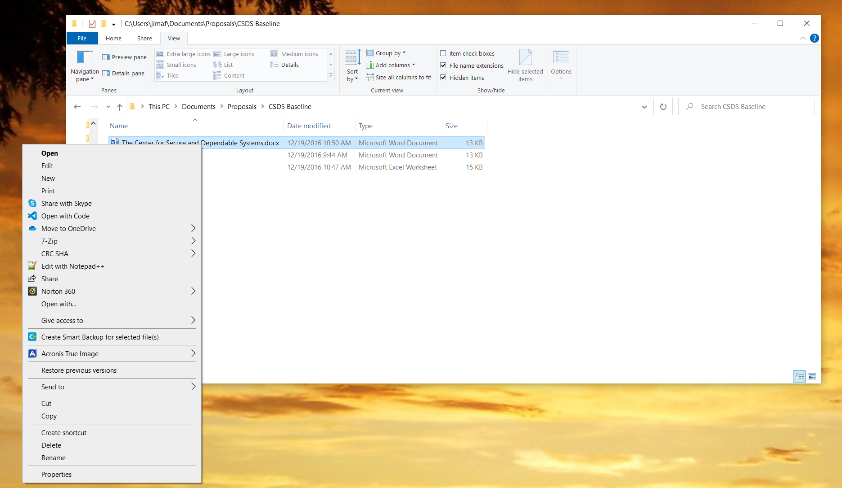
MS WINDOWS EXAMPLE OF ACL
Right Click on a File Name
Then Select Properties

Slide 10
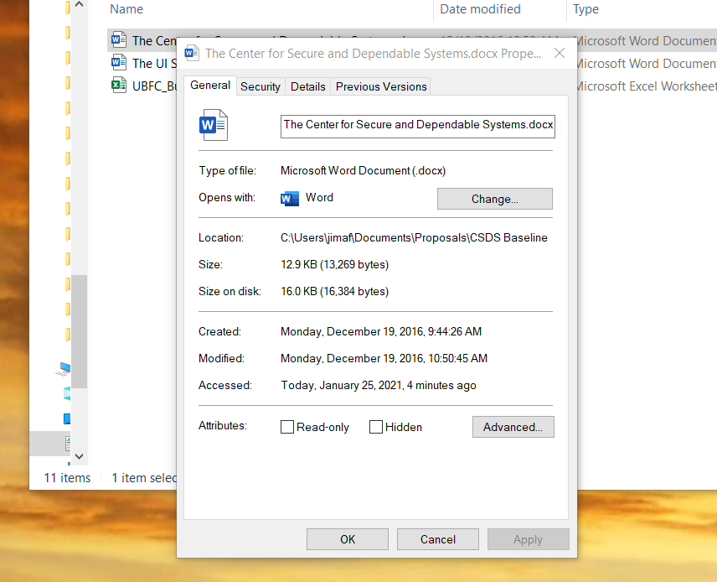
Then Select “Security”

Slide 11
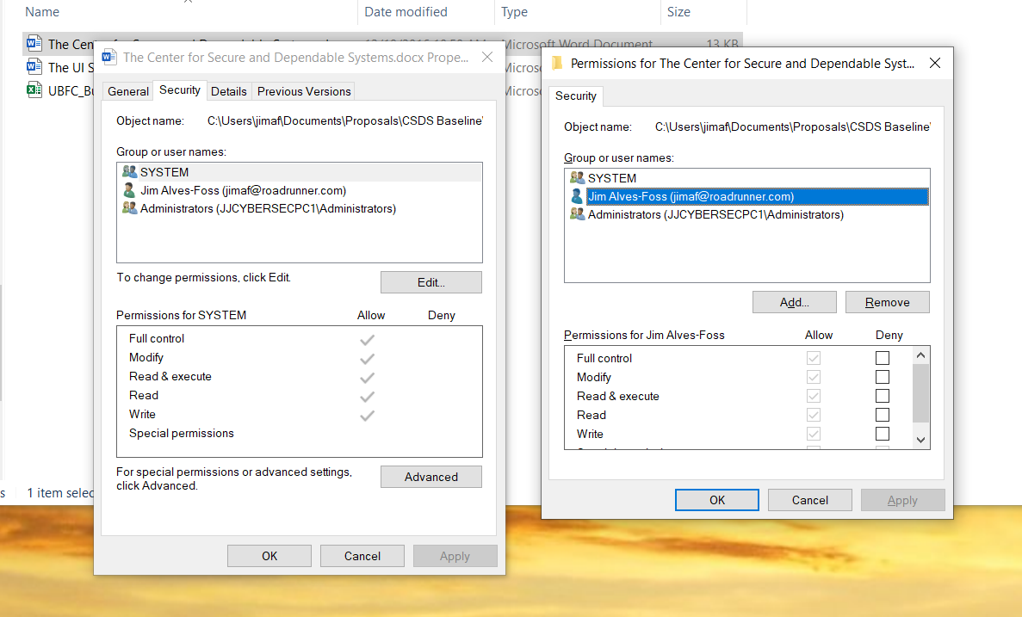

Slide 12
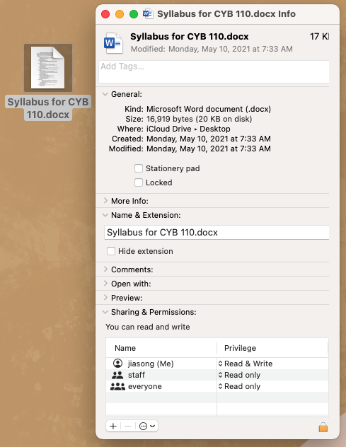
MACOS
Right click on the file
🡪 “get info”

Slide 13
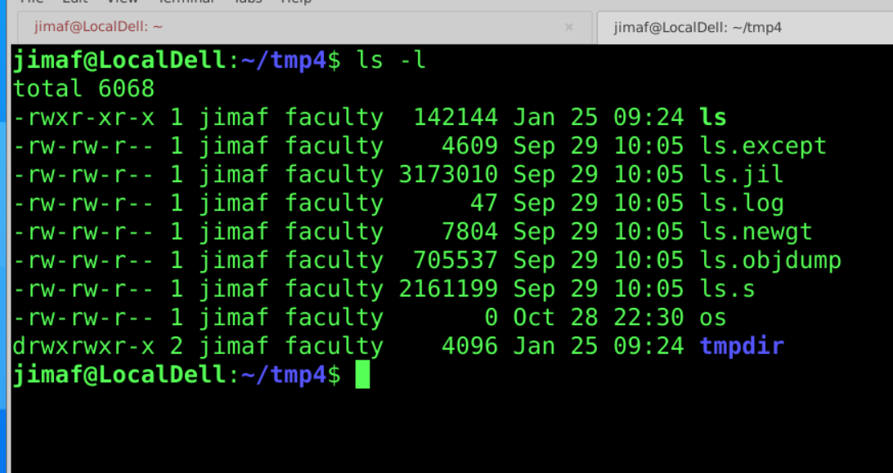
LINUX ACL

Slide 14
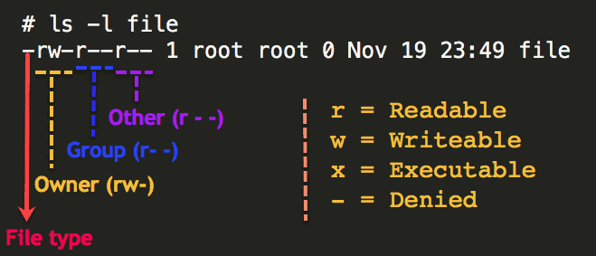
Permission | Description
Owner | Permissions used by the assigned owner of the file or directory
Group | Permissions used by members of the group that owns the file or directory
Other | Permissions used by all users other than the file owner, and members of the group that owns the file or the directory
Source: https://www.thegeekdiary.com/understanding-basic-file-permissions-and-ownership-in-linux/

Slide 15
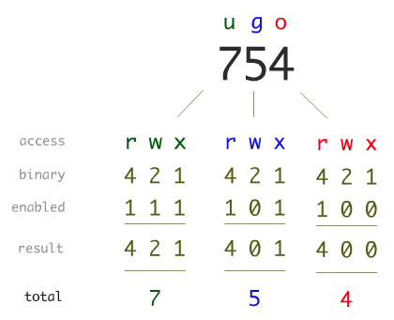
LINUX ACL (2)
Can modify a file’s permission (if you own it) for “user, group, others” for read/write/execute
chmod u+rw myfile
chmod u+x myfile
chmod go-wx myfile
(people will use octal numbers for these too – it is bad practice, but common)
chmod 644 myfile 🡺
user = read + write, group = read, others = read
Pic source: https://devopscube.com/linux-file-permissions-tutorial-for-beginners/

Slide 16
ACL BEYOND THE FILE SYSTEM
Network ACL: Usually based on machine identifiers/message contents
Can machine Alice send message of type XX to machine Bob?
Usually implemented in firewalls and routers (also IPS and IDS)
(Details will be in a later chapter, but for now…)
Network Messages (usually called packets) contain Media Access Control (MAC) and Internet Protocol (IP) addresses.
Message type usually dictated by a “protocol field” (such as TCP/UDP) and a port (80 for HTTP (web), 22 for SSH (secure shell), 143 for IMAP (email), 20&21 for FTP)

Slide 17
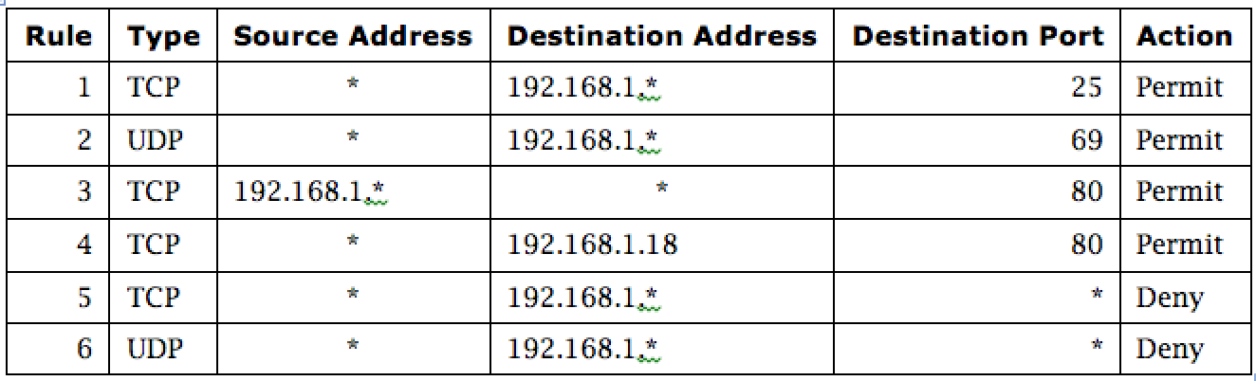
EXAMPLE: FIREWALL SECURITY POLICY
In this example firewall configuration,
External traffic can reach the entire internal network on TCP/25 and UDP/69.
Internal traffic can go out to port 80 on the external network.
External traffic can reach TCP/80 on one internal server.
All other traffic from external to internal is disallowed.
Notes:
In this example firewall configuration,
External traffic can reach the entire internal network on TCP/25 and UDP/69.
Internal traffic can go out to port 80 on the external network.
External traffic can reach TCP/80 on one internal server.
All other traffic from external to internal is disallowed.

Slide 18
CAPABILITIES
Some access control systems use “capabilities” (token, key).
Access control based on a given resource, an identity, and a set of permissions.
In capability-based systems, the right to access a resource is based entirely on possession of the token, rather than who possesses it.
These can be shared with other users (with same or less authorization)
Details are beyond the scope of this course

Slide 19
ACCESS CONTROL MODELS
DAC (Discretionary Access Control): The owner of the file controls access (DAC is implemented in most OSs).
MAC (Mandatory Access Control): The system enforces some limits (think Top-Secret versus Secret). The owner of the object doesn’t get to decide who gets to access it. A separate group or individual has the authority to set access to resources.
Rule-Based Access Control: Typically found in networks. External IP address may send request to port 443 (HTTPS) on machine Sally.
Role-Based Access Control: Instead of using User ID to make decision, use “role” (faculty, supervisor, developer, team lead, tester,…) to make decisions.

Slide 20
RULE-BASED ACCESS CONTROL (RBAC)
Rule-Based Access Control: allows access according to a set of rules defined by the system administrator.
Example: ACL used by a router (next slide)

Slide 21
EXAMPLE: RULE-BASED AC
In this example firewall configuration,
External traffic can reach the entire internal network on TCP/25 and UDP/69.
Internal traffic can go out to port 80 on the external network.
External traffic can reach TCP/80 on one internal server.
All other traffic from external to internal is disallowed.
Notes:
In this example firewall configuration,
External traffic can reach the entire internal network on TCP/25 and UDP/69.
Internal traffic can go out to port 80 on the external network.
External traffic can reach TCP/80 on one internal server.
All other traffic from external to internal is disallowed.

Slide 22
ROLE-BASED ACCESS CONTROL (RBAC)
Role-based access control lets us associate privileges with groups.
Students in one class
Faculty in one department
Staff in one department
Access control by role recognizes common needs of all members of a set of subjects.

Slide 23
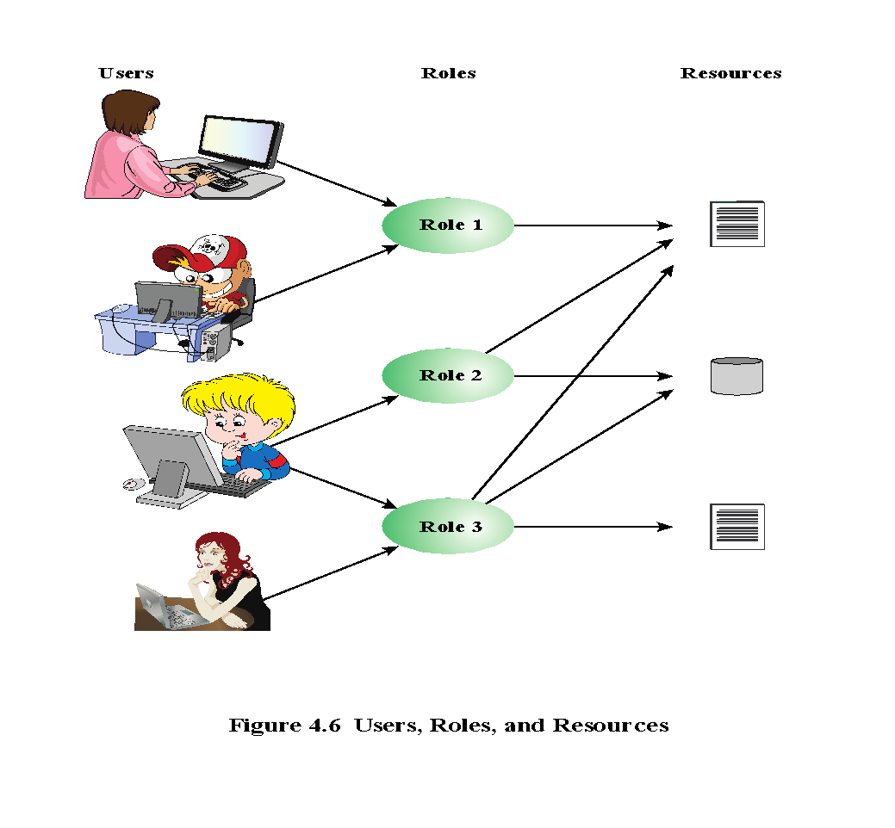

Slide 24
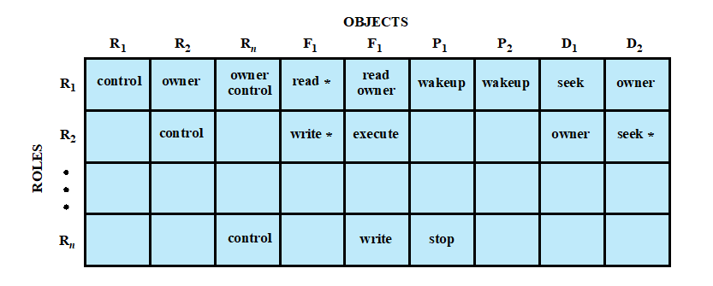
ROLE-BASED ACCESS CONTROL

Slide 25
ACCESS CONTROL POLICIES (2)
Attribute-Based Access Control: Decisions based on specific attributes (possession of an access card, time, date, location)
Multilevel Access Control: This is the “Defense in Depth” of access control policies. Where more than one policy is used to control access.
Example: In US Government, we have designating authorities, who decide what classification level a document has.
The Bell-LaPadula model
The Biba model
The Brewer and Nash model (Chinese Wall model)

Slide 26
ACCESS CONTROL MODELS (3)
Biba integrity model. Similar to Bell-Lapadula, but focus is on integrity.
Simple :Integrity Property: A user with integrity C can only read documents at integrity classification D if D dominates C (no trusting lower integrity)
* Property: A user with integrity clearance C can only write documents at integrity classification D if C dominates D (can not write to higher integrity)

Slide 27
MULTILEVEL SECURITY MODEL
Bell-LaPadula (BLP) Model (most influential)
Biba Integrity Model
The brewer and Nash model (Chinese Wall Model)
Notes:
First two are multilevel security models
Third one is a commercial model

Slide 28
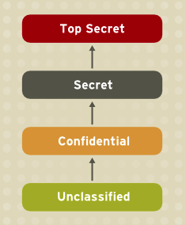
BELL-LAPADULA (BLP) MODEL
Developed in 1970s
Formal model for access control
Subjects and objects are assigned a security class
Top secret > secret > confidential > unclassified
Form a hierarchy and are referred to as security levels
A subject has a security clearance
An object has a security classification
Security classes control the manner by which a subject may access an object.
Notes:
The BLP model was developed in the 1970s as a formal model for access
control. The model relied on the access control concept described in Chapter 4
(e.g., Figure 4.4 ). In the model, each subject and each object is assigned a security
class . In the simplest formulation, security classes form a strict hierarchy and
are referred to as security levels . One example is the U.S. military classification
scheme:
top secret > secret > confidential > restricted > unclassified
It is possible to also add a set of categories or compartments to each security
level, so that a subject must be assigned both the appropriate level and category to
access an object. We ignore this refinement in the following discussion.
This concept is equally applicable in other areas, where information can be
organized into gross levels and categories and users can be granted clearances to
access certain categories of data. For example, the highest level of security might be
for strategic corporate planning documents and data, accessible by only corporate
officers and their staff; next might come sensitive financial and personnel data,
accessible only by administration personnel, corporate officers, and so on. This
suggests a classification scheme such as
strategic > sensitive > confidential > public
A subject is said to have a security clearance of a given level; an object is said to
have a security classification of a given level. The security classes control the manner
by which a subject may access an object.

Slide 29
A BLP EXAMPLE
Security classes control the manner by which a subject may access an object.
Primary goal of BLP is to protect confidentiality of the source.
Security level | Subject | Object
Top Secret | Alice | Personnel Files
Secret | Bob | E-Mail Files
Confidential | Charlie | Activity Logs
Unclassified | Dave | Telephone Lists

Slide 30
BELL-LAPADULA (BLP) MODEL
Multilevel security
No read up
Subject can only read an object of less or equal security level
Referred to as the simple security property (ss-property)
No write down
A subject can only write into an object of greater or equal security level
Referred to as the *-property
Notes:
The model defined four access modes,
although the authors pointed out that in specific implementation environments, a
different set of modes might be used. The modes are as follows:
• read: The subject is allowed only read access to the object.
• append: The subject is allowed only write access to the object.
• write: The subject is allowed both read and write access to the object.
• execute: The subject is allowed neither read nor write access to the object but
may invoke the object for execution.
When multiple categories or levels of data are defined, the requirement is
referred to as multilevel security (MLS). The general statement of the requirement for
confidentiality-centered multilevel security is that a subject at a high level may not
convey information to a subject at a lower level unless that flow accurately reflects
the will of an authorized user as revealed by an authorized declassification. For
implementation purposes, this requirement is in two parts and is simply stated.
A multilevel secure system for confidentiality must enforce the following:
• No read up: A subject can only read an object of less or equal security level.
This is referred to in the literature as the simple security property (ss-property) .
• No write down: A subject can only write into an object of greater or equal
security level. This is referred to in the literature as the *-property (pronounced
star property ).

Slide 31
BELL-LAPADULA (BLP) MODEL
No read up (simple security property (ss-property))
Subject can only read an object of less or equal security level
No write down (*-property)
A subject can only write into an object of greater or equal security level
Security level | Subject | Object
Top Secret | Alice | Personnel Files
Secret | Bob | E-Mail Files
Confidential | Charlie | Activity Logs
Unclassified | Dave | Telephone Lists

Slide 32
COMPUTER SECURITY MODEL
Bell-LaPadula (BLP) Model
Biba Integrity Model
The brewer and Nash model (Chinese Wall Model)
Notes:
First two are multilevel security models
Third one is a commercial model

Slide 33
BIBA INTEGRITY MODEL
The BLP model deals with confidentiality and is concerned with unauthorized disclosure of information.
A model developed by Ken Biba which is often referred to as “Bell-LaPadula upside down.”
It deals with integrity alone and ignores confidentiality entirely.
Notes:
The BLP model deals with confidentiality and is concerned with unauthorized
disclosure of information. The Biba [BIBA77] models deals with integrity and is concerned
with the unauthorized modification of data. The Biba model is intended to
deal with the case in which there is data that must be visible to users at multiple or all
security levels but should only be modified in controlled ways by authorized agents.
The basic elements of the Biba model have the same structure as the BLP
model. As with BLP, the Biba model deals with subjects and objects. Each subject
and object is assigned an integrity level, denoted as I( S ) and I( O ) for subject S and
object O , respectively. A simple hierarchical classification can be used, in which there
is a strict ordering of levels from lowest to highest. As in the BLP model, it is also
possible to add a set of categories to the classification scheme; this we ignore here.
The model considers the following access modes:
• Modify: To write or update information in an object
• Observe: To read information in an object
• Execute: To execute an object
• Invoke: Communication from one subject to another
The first three modes are analogous to BLP access modes. The invoke mode is
new. Biba then proposes a number of alternative policies that can be imposed on this
model. The most relevant is the strict integrity policy, based on the following rules:
• Simple integrity: A subject can modify an object only if the integrity level of
the subject dominates the integrity level of the object: I( S ) ≥ I( O ).
• Integrity confinement: A subject can read an object only if the integrity level
of the subject is dominated by the integrity level of the object: I( S ) ≤ I( O ).
• Invocation property: A subject can invoke another subject only if the integrity
level of the first subject dominates the integrity level of the second subject:
I( S ₁ ) ≥ I( S ₂ ).
The first two rules are analogous to those of the BLP model but are concerned
with integrity and reverse the significance of read and write. The simple integrity rule
is the logical write-up restriction that prevents contamination of high-integrity data.
Figure 13.4 illustrates the need for the integrity confinement rule. A low-integrity
process may read low-integrity data but is prevented from contaminating a high integrity
file with that data by the simple integrity rule. If only this rule is in force, a
high-integrity process could conceivably copy low-integrity data into a high-integrity
file. Normally, one would trust a high-integrity process to not contaminate a high integrity
file, but either an error in the process code or a Trojan horse could result in
such contamination; hence the need for the integrity confinement rule.

Slide 34
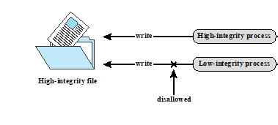
BIBA INTEGRITY MODEL
Each subject and object is assigned an integrity level, denoted as I( S ) and I( O ) for subject S and object O.
Strict integrity policy:
Simple integrity: “no write up”
A subject can modify an object only if the integrity level of the subject dominates the integrity level of the object.
Integrity confinement: “no read down”
A subject can read an object only if the integrity level of the subject is dominated by the integrity level of the object.

Slide 35
COMPUTER SECURITY MODEL
Bell-LaPadula (BLP) Model
Biba Integrity Model
The brewer and Nash model (Chinese Wall Model)
Notes:
First two are multilevel security models
Third one is a commercial model

Slide 36
THE BREWER AND NASH MODEL
The brewer and Nash model (Chinese Wall Model) takes a quite different approach to specifying integrity and confidentiality than any of the approaches we have examined so far.
The model was developed for commercial applications in which conflicts of interest can arise.
The model makes use of both discretionary and mandatory access control concepts.

Slide 37
THE BREWER AND NASH MODEL
Problem:
Tony advises Bank of America about investments
He is asked to advise Chase Bank about investments
Conflict of interest to accept, because his advice for either bank would affect his advice to the other bank

Slide 38
THE BREWER AND NASH MODEL
The elements of the model are the following:
Subjects: Active entities that may wish to access protected objects; includes users and processes
Information: Corporate information organized into a hierarchy with three levels
Objects: items of information related to a company
Dataset (DS): contains objects related to a single company
Conflict of interest (CI) class: contains datasets of companies in competition
Access rules: Rules for read and write access.

Slide 39
COI EXAMPLE
Bank COI Class
Gasoline Company COI Class
Bank of
America
Shell Oil
Conoco
Citibank
Chase
mobile
76

Slide 40
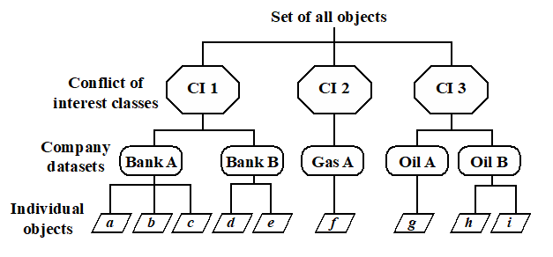
THE BREWER AND NASH MODEL

Slide 41
THE BREWER AND NASH MODEL
To enforce the Chinese wall policy, two rules are needed.
The first rule is the simple security rule:
A subject S can read on object O only if
O is in the same DS as an object already accessed by S, OR
O belongs to a CI from which S has not yet accessed any information

Slide 42
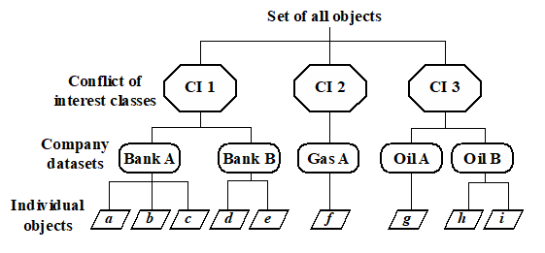
THE BREWER AND NASH MODEL
simple security rule:
A subject S can read on object O only if
O is in the same DS as an object already accessed by S, OR
O belongs to a CI from which S has not yet accessed any information

Slide 43
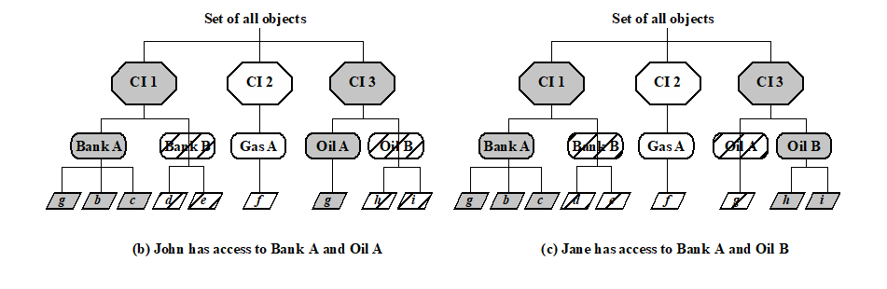
simple security rule:
A subject S can read on object O only if
O is in the same DS as an object already accessed by S, OR
O belongs to a CI from which S has not yet accessed any information

Slide 44
simple security rule:
A subject S can read on object O only if
O is in the same DS as an object already accessed by S, OR
O belongs to a CI from which S has not yet accessed any information
Notes:
A problem

Slide 45
CHINESE WALL MODEL (CWM)
To enforce the Chinese wall policy, two rules are needed.
*-property rule:
A subject S can write an object O only if
S can read O according to the simple security rule, AND
All objects that S can read are in the same DS as O.

Slide 46
*-property rule:
A subject S can write an object O only if
S can read O according to the simple security rule, AND
All objects that S can read are in the same DS as O.

Slide 47
REFERENCES
[NIST] Richard Kissel. “Glossary of Key Information Security Terms”, NISTIR 7298 Revision 2, National Institute of Standards and Technology, U.S. Department of Commerce, May 2013.
[Pfleeger] C. P. Pfleeger, S. L. Pfleeger, J. Margulies. “Security in Computing”, Fifth Edition, Prentice Hall, 2015.
[Knight98] Knight E. and Hartley C. “The Password Paradox”, Business Security Advisor Magazine, Dec 1998.
[GRA72] Graham, S. and Denning, P. “Protection - principles and practice.” Proc AFIPS spring Joint Computer Conf, 1972, p417-429.

Slide 48
PLEASE ATTRIBUTE DR. JIM ALVES-FOSS AND DR. JIA SONG, UNIVERSITY OF IDAHO EXCEPT WHERE OTHERWISE NOTED, THIS WORK IS LICENSED UNDER HTTPS://CREATIVECOMMONS.ORG/LICENSES/BY-NC-SA/4.0/ NOT WITHSTANDING THE NON-COMMERCIAL LICENSE TERMS, NON-PROFIT EDUCATIONAL INSTITUTIONS ARE GRANTED A NON-EXCLUSIVE LICENSE TO ADAPT AND USE THIS MATERIAL, WITH ATTRIBUTION. CREATIVE COMMONS AND THE DOUBLE C IN A CIRCLE ARE REGISTERED TRADEMARKS OF CREATIVE COMMONS IN THE UNITED STATES AND OTHER COUNTRIES. THIRD PARTY MARKS AND BRANDS ARE THE PROPERTY OF THEIR RESPECTIVE HOLDERS.

